Slide 1
Disp
Dreaming across Time and Space…
Montague Ullman and
an Order of Wholeness
Copyright © 2018 Judy B. Gardiner All rights reserved
Notes:
Very happy to back in Gdansk and sharing the life’s work of Montague Ullman
known popularly as Monte. I was the experiential counterpart to his theoretical side.
Our effort to understand the Wholeness of dreams will reflect:
Dream Sharing and it’s stages
Functions of dreaming
Personal-transpersonal nature of dreams
Collective Unconscious

Slide 2
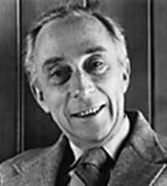
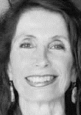
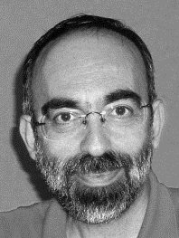
Confronting
What
Is
an introduction to MONTAGUE ULLMAN DREAM GROUP
Judy Gardiner, USA
dream facilitator
Massimo Schinco, ITALY
psychotherapist
Notes:
It is Monte’s dream come true that The Ullman Dream Group Process is now on the curriculum at
University of Gdansk, thanks to the enthusiasm and dedicated efforts of Prof. Wojciech Owczarski.
CONFRONTING WHAT IS was a Montague Ullman dream group
workshop that Massimo Schinco (Milan) and I presented at the
2014 Gdansk Dream conference. I WELCOME Prof. Anna Anzani
who will present her combined work with Massimo.
Monte and I discovered bi-directional dreaming where dreams point outward as well as inward. This
includes events outside the range of our personal dreams like dreams about nature and the earth.

Slide 3
Montague Ullman (1916 – 2008), psychiatrist, neurologist and parapsychologist founded the Dream Laboratory at the Maimonides Medical Center, Brooklyn, N.Y.
for over two decades he taught psychoanalytic candidates in Sweden, later teaching his group process to professional and lay groups alike
he devoted his life to lecturing, teaching and inspiring a grassroots dream work movement within the United States
the process, having spread internationally, reflects a gradual shift in dream ideology and an upsurge in popular interest in dreams
Judy Gardiner, USA
dream facilitator
Massimo Schinco, Italy
psychotherapist
Notes:
At Maimonides he conducted dream research experiments with ESP and wrote a book called “Dream Telepathy.” Monte’s interest in the paranormal began with a group of college friends who held seances for two years. An account titled the Bindelof Story is on his website.

Slide 4
Ullman emphasizes that
“we are much less separate
than we think we are”
and that dreaming is
“an adaptation concerned with
the survival of the species and only
secondarily of the individual”
Judy Gardiner, USA
dream facilitator
Massimo Schinco, Italy
psychotherapist

Slide 5
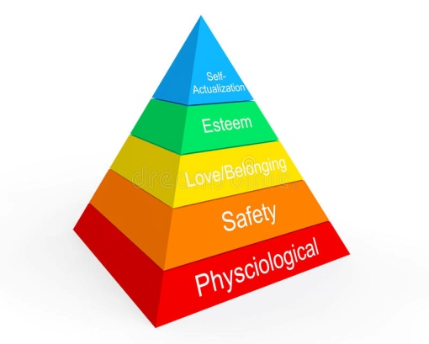
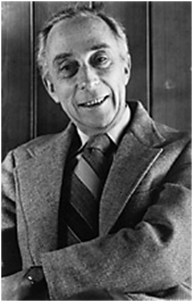
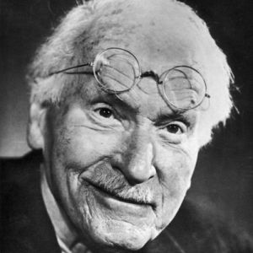
Abraham Maslow
1908 - 1970
Montague Ullman
1916 - 2008
Carl Gustav Jung
1875 - 1961
Pyramid to self-actualization: A persons motivation to reach his or her full potential.
The collective unconscious is a
storehouse of latent memories of
our human and prehuman ancestry.
Dreams reflect self and universe: the basic truth that we are members of a single species.
Notes:
Maslow’s theory of self-actualization – based on personal growth present in a person’s life to attain full potential
Jung’s collective unconscious – structures of the unconscious mind shared among beings of the same species.
Ullman’s species connectedness -– combined Maslow & Jung’s theories – initiated Dream Sharing & WHOLENESS – which is what we’ll be covering today.
Montague Ullman expanded dreamwork beyond the consulting room into the community so all dreamers could experience a sense of sharing which he referred to as species-connectedness.

Slide 6
A Collaborative Dream Hierarchy to Self-Actualization
SPIRITUAL
COSMIC TRANSPERSONAL
Collective Unconscious
Enlarges worldview
Transformational
Survival of species
SOCIAL Society’s influence: government • culture • environment workplace
Cultivates discoveries
PSYCHOLOGICAL
Awakens potential
Anxieties • shortcomings • self-esteem
Past issues • Problem solving • Relationships
BIOLOGICAL
Survival of self
Health • Bodily requirements
Depression
Family influences
Notes:
MONTE’S approach: Dreams serve 4 functions: biological, psychological, social, & spiritual.
The pyramid shows an ascension to higher consciousness from Self to Species.
Monte’s contribution: was evolution from the personal (lower 3 tiers) to transpersonal
dimension (apex of pyramid).

Slide 7
dreamwork goes through 4 different stages
the group is asked not to interpret someone else’s dream
to reinforce this, before commenting, the dream sharing uses a technique known as «if it were my dream»
this is much more than a slogan
Judy Gardiner, USA
dream facilitator
Massimo Schinco, Italy
psychotherapist

Slide 8
4 stages of the Ullman Process
Stage 1 – Dreamer shares dream with dream group Group asks clarifying questions
Stage 2 - IF IT WERE MY DREAM Dream group participants make the dream their own
Stage 3 – Dreamer’s response Context, Playback, Orchestration
Stage 4 – Dreamer has final word.
Notes:
Stage 1:
Dreamer shares dream w/ group
Clarifying questions:
Dream group asks clarifying question:
age in dream? feelings while dreaming? dark or light?
describe the setting
Stage 2: IWMD - Dream group participants make dream their own
Stage 3: Dreamer takes notes and responds to group
CONTEXT Group searches for events & emotional context.
Occurring in life - feelings around time of the dream?
Begin from most recent & work back, one step at a time.
PLAYBACK: one person reads dream aloud, one scene at a time.
Try to spot metaphors & help dreamer make further connections.
ORCHESTRATION:
Group members projections. No judgment – no analysis.
Dreamers respond with as much or as little as he/she wants
Stage 4 – Dreamer has final word. If group meets regularly, at
next meeting dreamer can share insights related to the dream group input.

Slide 9
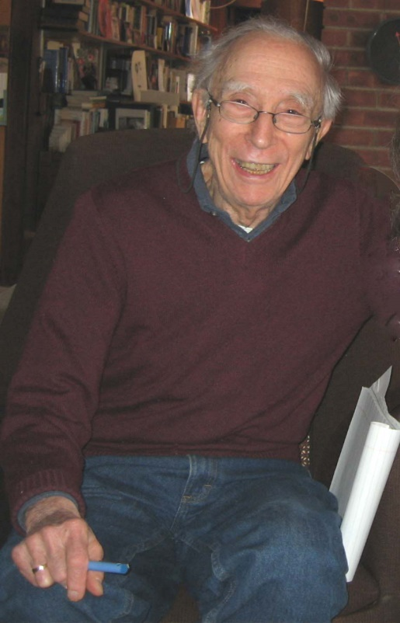
IF IT WERE MY DREAM making the dream your own Dream sharing is fun and connects us to each other
“Dream sharing is like communion”

Slide 10
“dreaming is a pictorial elocution, a way of talking in pictures”
so that
“the dream is a metaphor in motion"
by virtue of which
“dreams can offer an aesthetic and creative approach to knowledge, oriented to wisdom, which is complementary to the “objective” one of science, oriented rather to mastery”
Judy Gardiner, USA
dream facilitator
Massimo Schinco, Italy
psychotherapist
Notes:
Metaphor: when two compared things are identical and substitutes one for the other.
Metaphor: A dream is a feather. It is soft and fluffy and disappears quickly.

Slide 11
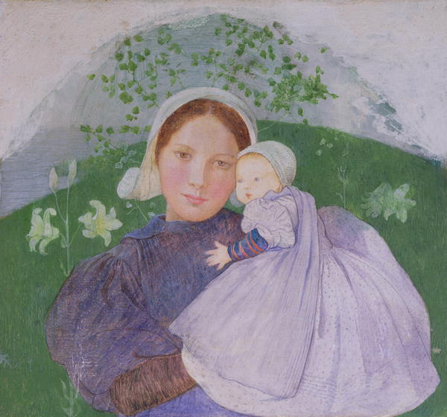
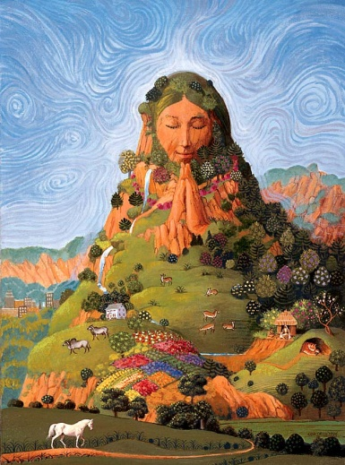
METAPHOR IN MOTION
The dream as a whole creates a unified, major metaphor. Mother: environmental metaphor for Mother Earth
… a nurturing, guiding, sometimes disruptive force of Nature
A key to understanding a dream metaphor is “day residue” – bits of the waking day that confront the dreamer with new data, or force confrontation of one’s behavior.
Birth Mother
Mother Earth
Notes:
I’ll use the metaphor of Mother as that is how my dreams began … with my Birth Mother.

Slide 12
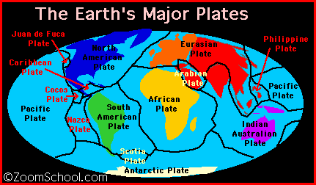
METAPHOR: MOTHER
Birth Mother + Earth = Mother Earth
Mother - cue word Mother + Earth = Non-separable entity
Plate + Earth = PlateTectonics
Notes:
Dreams of BIRTH MOTHER.
Curious dreams about her floors. Ex: mashed potatoes –potassium – Urine Uranium – In ecstasy crossing from one theatre to another. Ecstasy translated to geologic term for Isostacy - response to a type of erosion where an entire mountain range can be lifted
Repetitive dreams of PLATES: license, x-ray, baseball.
Breastplate symbolic of Mother – Tectonic plates. (Eurasian, North American, African, Indo-Australian,Juan de Fuca).

Slide 13
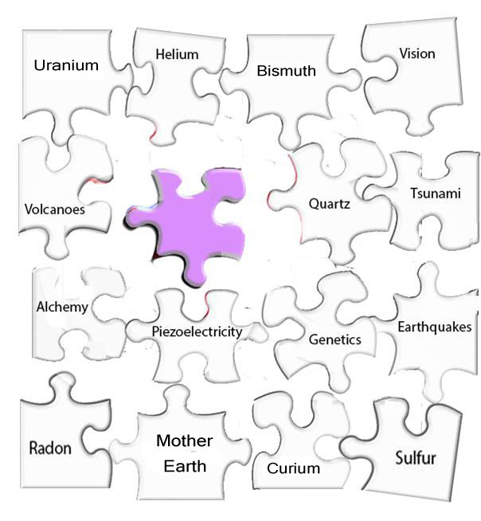
DREAMING MOTHER EARTH
A fragmented, yet integrated structure
Birth
Mother
Notes:
13
Chaos theory – fragments looking to cohere
Beginning 1993 dreams inundated me with a range of sciences, none I had studied.
Birth mother lavender piece in the center - MYSTERY for many years. It eventually represented my birth mother, nurturing as Mother Earth, but exhibited explosive, eruptive behavior. Here the transition from personal began to augment to transpersonal.
The mentors revealed many fragments which demanded connection.
Dream symbology translated to TECTONIC PLATES, seafloor spreading, subduction zones, hot spots −
joined with − gases, metals, and minerals.
As warnings accelerated. Geology and Chemistry took center stage.

Slide 14
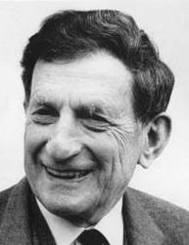
from a theoretical point of view Ullmann roots his statements in the contribution of the physicist David Bohm
for Bohm, consciousness is envisioned as an infinite collective stream in which the contents of individual consciousness are distinct but not separate explications of “wider” implicate orders
Judy Gardiner, USA
dream facilitator
Massimo Schinco, Italy
psychotherapist
Notes:
Monte’s interest in the relevance of quantum theory to dreaming was awakened in 1974 when he attended a week long dialogue between David Bohm & Krishnamurti. the Indian Philosopher. Monte frequently regretted that he was not a physicist.

Slide 15
IMPLICATE ORDER
Order of wholeness in which “all that is”
is interconnected including dreams
Dreaming consciousness
functions as a relay station
receiving input from both orders
guiding us toward wholeness. .
EXPLICATE ORDER
Order in which “all that is”
unfolds from the Implicate
Notes:
Monte analogized the nature of dreaming consciousness to Bohm’s theory of a seamless whole out of which the Explicate arises.
Top: Implicate order – Dreams open up our remote memory bank & free us from space & time.
Bottom: Explicate order – Dream content triggered by unresolved feelings rising to the surface.
Center: a relay station receiving input fr both orders:

Slide 16
reality “explicates” and “implicates” itself in an endless “holomovement” – the movement of the whole
***************************
consequently, all conceptions considering individual vs. collective, psychological vs. “material”
past, present and future as ultimately separated one from the other
are no longer accepted
Judy Gardiner, USA
dream facilitator
Massimo Schinco, Italy
psychotherapist

Slide 17
HOLOMOVEMENT
COSMIC
Mind-Matter Interaction
BIOLOGIC
BIOLOGIC
INFINITY
Notes:
Bohm & Ullman concurred on the movement of the whole. This little diagram actually came thru a dream.
Known as the LEMINISCATE, this is a plane curve consisting of two loops that meet at a central point – also recognized as a symbol for Infinity.
1) An ENDLESS HOLOMOVEMENT represents the flow of the WHOLE where dreams receive & exchange info from both cosmic & biologic fields (also transpersonal & personal) in an infinite loop.
2) Mind-matter content interact at the loop’s midpoint.
3) If memories are imprinted in our dreams –– the relationship between mind and matter suggests one of infinity.

Slide 18
consistent with this, Ullman’s view of dreams and dreaming is transpersonal
“dream work moves us into a transpersonal domain by drawing attention to the way we are living out our membership in a single species”
“in our dreams we struggle against fragmentation and move toward wholeness”
Judy Gardiner, USA
dream facilitator
Massimo Schinco, Italy
psychotherapist
Notes:
My years of dreaming and endless fragmentation laid the foundation for Monte’s & my work
in the transpersonal domain.

Slide 19
TRANSPERSONAL DOMAIN
THE COLLECTIVE UNCONSCIOUS
In Science and Spirit
in Life and in Death
Steno Ptolemy Galen Curie
Geology Astronomy Optics Chemistry
Notes:
Thus begins a story of how the Collective Unconscious came into my dreams – which I call Cosmic Dreaming.
Initially mysterious and confusing, it began my journey to SELF ACTUALIZATION.
These 4 historical figures visited my dreams, one by one, symbol by symbol, over two decades
& thousands of dreams, none of it making any sense. Individually & collectively, these
dream mentors issued relentless concern delivering a dire ecological and environmental warning to humankind.
Galen and Ptolemy taught me to see the light.
Steno and Curie showed me the inner workings of the earth.
At journey’s end I realized that the Collective Unconscious, was teaching the connectedness
and universality of dreaming and how visual memory can associate dream images and clues.

Slide 20
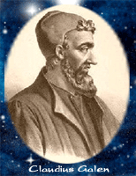
The Optic Nerve A Breakthrough for Mankind
Claudius Galen
11/11/94
The same key fit all six apartments, but no one knows it.
A puzzlement. 5 keys, 6 apartments?
Vision – Hearing – Smell
Taste – Touch
Notes:
• 1994 Dream: Deceased friend working on a breakthru for mankind.
Thus began a 20 year dream journey … Light and Vision led the way.
OPTIC NERVE. Dream image - key ring. – 5 keys
Dream said “Same key fit all 6 apts. But no one knows it.”
The keys represented the 5 senses. But what was the 6th?
Today, I have concluded that it is our “intuitive” nature.

Slide 21
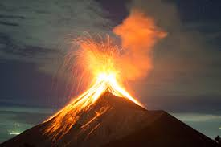
LAVENDER
An Entwined Adventure in
Science & Spirit
Dreaming
LAVENDER
flowers
Waking
LAVA UNDER
volcanism
Notes:
Years of long-term journaling produced mountains of notes and dreams. I knew it was leading somewhere but knew not where. This book was the vehicle.

Slide 22
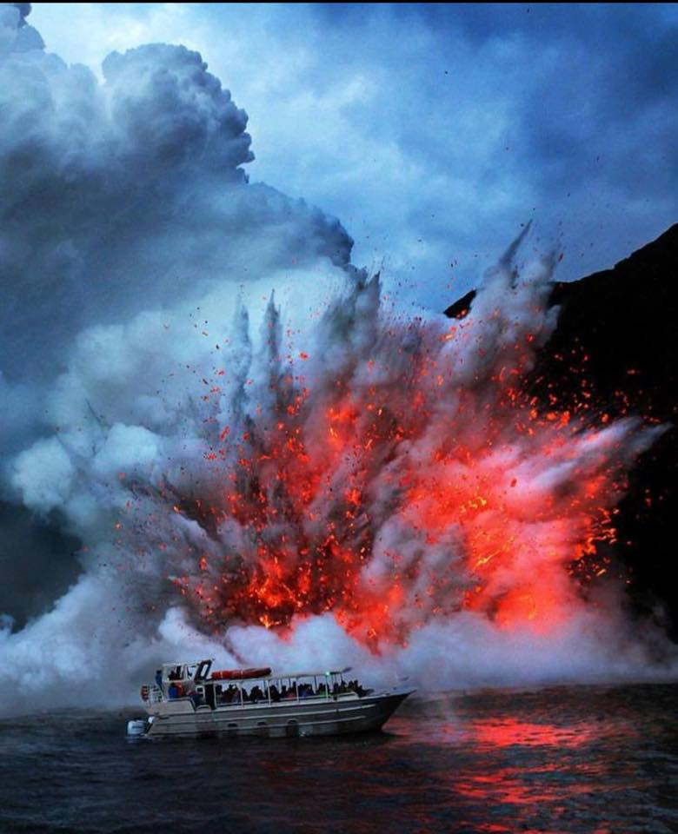
TRANSPERSONAL DOMAIN
Dreams point outward as well as inward.
Dreaming about cataclysms of nature links us more authentically not only to ourselves but to all forms of matter.
Hot Lava
Notes:
Light and vision were temporarily eclipsed by warnings for the Earth and our Species.

Slide 23
Plate tectonics, volcanoes, earthquakes, tsunami’s
Poisonous Butterfly Sulfur Dioxide Volcanoes
Sulfur volcanic gas
a sulfurous gas?
Something new …
self-turning eggs …
Notes:
SULFUR marked my foray into chemicals – from a butterfly called a Sulfur – to the mineral – to volcanic gas.
Caution of something new and self-turning eggs was curious … Was sulfur producing more sulfur in the form of a sulfurous gas which is toxic.

Slide 24
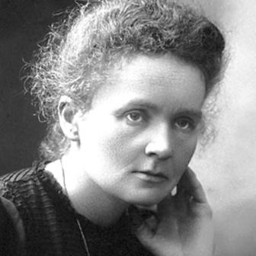
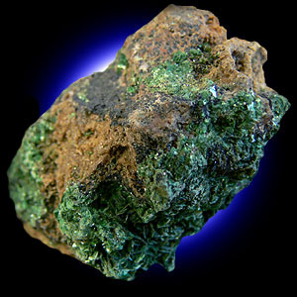
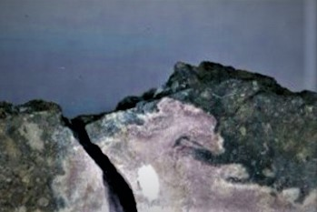
more gases – metals -- radioactive decay …
… I dreamed upside-down metal J’s
BISMUTH – radioactive isotope
decays into Polonium, named for Poland.
Marie Curie
Dreams of urine on mother’s floors = earth’s crust
URANIUM led to Curies’ discoveries of Radium and Polonium.
CURIUM
CURIOUS MARIE
Evidence of presence of Curium in early solar system 4.5 billion years ago
Curium: a radioactive metal named after
Pierre and Marie Curie
Notes:
more gases .. Helium, Chlorine, Fluorine, Radon and then came metals …
I dreamt upside down metal J’s.
Next day I saw actual Bismuth in a mining museum in Vancouver – a perfect match to my dream.
BISMUTH decays into Polonium which Marie Curie named for Poland.
A repeating dream was Urine on mother’s floors.
Mother Earth’s floors, the earth’s crust.
Urine - shorthand for Uranium and led to Curie’s discoveries
of Radium and Polonium.
CURIUM
Curium have been used in research and as power sources for space and medical practices.
(pacemakers)

Slide 25
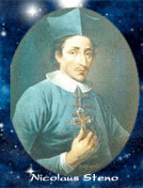
REAL ESTATE - ALCHEMY - CURIOUS MARIE 7/16/93
Are you an alchemist?
Nicholas Steno
Marie Curie
. I’m in real estate and I’m an alchemist People here do more than one thing.
5 - 250 cm
CURIUM
5 Sold 250 cm
Isotope Cm -250
Half Life 9700.0 Years
REAL ESTATE • Land / Geology • Steno
ALCHEMY • Chemistry • Marie Curie
Notes:
CURIUM
Even though curium has long-since decayed into a form of uranium, signs of its presence remain in a pinkish ceramic inclusion. This dream was about a floating pink carpet in Rockefeller Center.
all of its isotopes are radioactive and decay rapidly.
In 2016 an inclusion of Curium was found in a meteorite by scientists – Univ. Chicago.
Named CURIOUS MARIE. The finding ends a 35-year-old debate on its possible presence in the early solar system, and plays a crucial role in reassessing models of stellar evolution and synthesis of elements in stars.
Because Curium is not found in nature. all of its isotopes are radioactive and decay rapidly . It occurred to me that if a meteorite exploded, it would create a Crater. Curium binds to soil particles so it would be in the earth. That means it could be in our midst.

Slide 26
Visual Associative Recognition Memory in Dreams
• Visual memory stores dream cues (words/images)
• Recognition associates new with previous dream cues
• Memory network retrieves previous cues automatically
encoding them when activated by a corresponding word/image
• Entangled state occurs when two word/images become
associated within a new context.
• Cue words/images organize into non-separable entities or
themes simultaneously activating the entire associative structure
• Memory forms interrelated web of relationships
Copyright © 2014 Judy B. Gardiner
Notes:
Based on a quantum cognition model that employs word association I developed a simplified model of a mental lexicon as applied to my own dreams. Handouts are available.
Visual associative recognition memory in dreaming consciousness can form an interrelated web of relationships.
Thus, the Integrality of the Dream.

Slide 27
Associative Structure Fragmentation to Wholeness
Dream Symbol Scientific Referent Fragmented Subsets
Flashing light Lavender Lava Under
Pizza/Cousin Andi Piezo/Andesite Piezoelectricity
(electric discharge - volcanic rock)
Butterfly Sulfur (dioxide) Volcanic gas
Urine/Waste Uranium (Curium) Radioactive decay
Sulfuric Acid Hazardous waste
Self-turning eggs/ Sulfur producing sulfur
Alchemy transmutation Alchemical interaction
Theory: A radioactive sulfurous gas occurring in the earth
Notes:
MOTHER EARTH PUZZLE - Highlights of completed puzzle.
Left = dream symbols.
Center = transition from dream symbol to scientific referent
Right = fragmented subsets comprise the unified theme of Mother Earth
Sulfur – radioactive decay – volcanic & other gases, hazardous waste material, piezoelectricity = all contribute to this alchemical interaction.
Curium, know as a synthetic, radioactive rare earth metal produced artificially in nuclear reactors but discovered (2016) in a meteorite. Binds to soil particles.

Slide 28
Morphic fields can propagate across space and time
Morphic resonance is an influence
of similar things on subsequent similar things.
Rupert Sheldrake
Notes:
Self-organising systems inherit a memory from previous similar systems.
biologist a
According to Rupert Sheldrake, morphic field contains inherent memory through repetition. In this case, repetition was evident in dreams of chemical elements. geologic functions, earth processes. Have reason to think this repetition occurs in many dreams

Slide 29
GEOLOGY
NEUROSCIENCE
OPTICS
Earthquakes,
environment,
piezoelectricity, plate
tectonics, volcanology
Refraction: bending of
light, convergent vision,
electrical signals,
memory storage
Visual pathway – optic nerve - optic disc,
synapse formation,
hormones
PALEOANTHROPOLOGY
CHEMISTRY
Australian Aboriginals, Isle of Wight, genetic drift, fossils
Gases, chemicals,
radioactivity, Alchemy
Collective Unconscious
These dream mentors collaborated in symbolizing content.
PHYSICS
Implicate Order, speed of light, Chaos Theory, String Theory, Loop quantum gravity, microwave background radiation, Electromagnetism,
Monopoles, Hysteresis
ASTROPHYSICS
Ptolemy’s Star Cluster,
Andromeda Galaxy,
Schwarzschild Black
Hole (light cones)
Ptolemy
Curie
Steno
Galen
Ancestral Memory
MATHEMATICS
GENETICS
Infinity Theorems
Lemniscate, Pascal’s Triangle, Pythagorean Triples, Greek codes - Omega
DNA, amber,
Double helix,
Gregor Mendel, pyrimidine bases
MYTHS & LEGENDS
Aboriginal Dreamtime, Andromeda, Emerald Tablet, Hollow Earth, Holy Grail, Osiris, Rosetta Stone, Rosicrucian Order, Upanishads’ Vedanta
Notes:
The Collective Unconscious imbued in the science & spirit of 4 unforgettable figures of history revealed the timelessness of their work and our lives on earth.
Years of research, connecting dots, and developing a homegrown symbol system shaped my theory that the fragmentary nature of dreams seeks wholeness deriving from the collective unconscious.
Remember, it all began with a stream of personal dreams.
I’ll now quote from ….Carl Jung:
“The collective unconscious contains the whole spiritual heritage of mankind’s evolution…”
29

Slide 30
Phenomenological implications
Telepathy
Retro-
cognition
(past)
Pre-
cognition (future)
Clairvoyance
Is the collective unconscious present in all states:
waking, dreaming and afterlife.
Notes:
Our dreams can look backward and forward simultaneously.
Bidirectional potential shows that dreams can reach a broader domain suggesting;
telepathic dreams span across space;
pre- & retrocognitive dream, across time.
As our global equilibrium is increasingly threatened, our dreams may have neurophysiological implications that we are developing psychic capacities that respond to those threats.

Slide 31
DREAMING ~ AN ORDER OF WHOLENESS
• transmits direct experience of self and world
as participants in a totality
• reflects dream content inward and outward
• develops empathy and compassion
• opens to the collective unconscious
• enfolds past, present and future
Notes:
I hope this talk has given you a glimpse into the wholeness of dreaming and how it can unfold to a web of interconnected relationships in both waking and dreaming consciousness. Dreams were showing me the unseen behavior within the earth affected by climate change and ecological crisis.

Slide 32
Montague Ullman: 1916 - 2008
Dreams present authentic feelings,
the true source of our
connective tissue.
Notes:
Like the story of The Little Prince, Monte, leaves the safety of his own tiny planet to travel the universe of the subconscious. Here, he learns about his own inner child and adult behavior. Through years of extraordinary dreamwork, his personal odyssey teaches us the value of the dream so that he can teach others.
Thank you for listening. I know it’s not easy in 2 different languages: English & Dream.

